Slide 1
Taking the wheel
Resilient Driver’s Program
Notes:
Taking the Wheel
Teacher Notes

Slide 2
Instructions.
This workshop is designed to be teacher-led.
You can print off this presentation in ‘notes format’ to assist with the delivery of the workshop – the suggested script is included.
An activity sheet can be printed off for students to complete during or after the presentation is delivered.
Notes:
How to use this resource:
Project this PowerPoint and present to the students as directed, or students can self-pace individually
Print off this document in colour in ‘notes format’ which will show the teacher notes at the bottom of each page – questions to ask the students are red
The ‘Student Worksheet’ and ‘Teacher Answers’ documents should be printed in colour
Materials required:
Computer access for all students with access to the internet
or
Smartboard/PC and projector
Class set of worksheets
Pen & highlighter for each student

Slide 3

What we’re looking at today .
The licensing system
Practical driving assessment
Hazard perception test
Notes:
Notes:
The topics of todays workshop are:
The licencing system
Practical driving assessment (PDA)
Hazard perception test

Slide 4
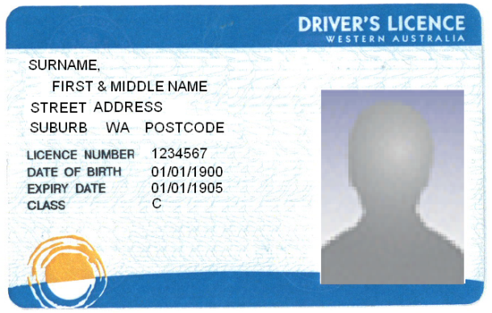

Drivers license steps.
1. Learner’s Permit
Theory test – multiple choice
Minimum age, 16 years
6. ‘P’ Plates
Minimum age, 17 years
2. Learner Phase 1
completion of first half of log book with a minimum of 25 hours
5. Practical Driving Assessment
Practical Driving Assessment (PDA) – practical driving test at a licensing centre at a minimum of 17 years old.
3. Hazard Perception Test
Hazard Perception Test – computerised test completed at a licensing centre.
4. Learner Phase 2
completion of second half of log book with a minimum of 25 hours
5 hours of night driving must be included with completed 50 hours logged
Notes:
Notes:
ASK: How many questions do you have get right to pass the learners permit test?
Answer: 24 out of 30 (80%)
Step 2
This is the stage where you go for driving lessons with a supervisor driver and/or a driving school.
A supervised driver is someone who has held their licence for 4 or more years.
Step 3
Make sure you book your Practical Driving Assessment (PDA) months in advance. There could be up to a 3 month waiting period.
25 hours: 25 hours is the minimum amount of hours you must log under supervision. All research shows that the more supervised driving experience you have the more you lower your crash risk in the first 2 years of driving.
Step 4
25 hours is the minimum amount of hours you must log under supervision.
100 to 120 quality supervised driving hours is recommended for both phases.
Step 5
Hazard Perception Test is a computer based test scenario.
The test consists of 28 video scenes and for each scene, you will be given one of the following driving tasks:
Slow down
Overtake
Make your turn
Moving off
Step 6
Receive your drivers licence you are on Red P plates for the 1st 6 months and then Green P plates for the next 18 months.

Slide 5
The licensing system.
16 yrs
(min)
16½ yrs
(min)
17 yrs
(min)
19 yrs
(min)
L
L
P
P
25 hours in
log book
25 hours in
log book
6 months
18 months
(min 6 months)
Learner
theory test
Hazard
perception
test
Practical
driving
assessment
Notes:
Notes:
The licensing system has changed significantly in the last few years.
ASK: What are some of the tests or requirements for moving from one phase to another?
Background information:
Learner Theory Test:
Multiple choice test
Can be practiced online at the Department of Transport (DoT) website
Pass score of 24/30
Receive Learner’s Permit upon completion and pass of Theory Test
Phase 1:
Log Book – must log at least 25 hours with supervisor (someone who has held their license for more than 4 years)
Must be at least 16 years of age.
Hazard Perception Test:
Computer-based test
Features a series of moving traffic scenes to measure a person’s ability to assess traffic situations and make safe driving decisions
Must be at least 16 years and 6 months age. Must have been in this phase for 6 months.
Completed 25 hours of driving with supervisor
Phase 2:
Practical Driving Assessment (PDA)
Approximately 45 minutes
Five sections
3 sections: following directions
2 sections: exercises ‘Left Something Behind’ and ‘Stopping for Shopping’
Graduate to Phase 2 upon completion and pass of PDA
Must be 17 years of age
Completed log book with a total of 50 hours including 5 hours of night driving.
P (provisional) plates:
6 months on red P plates
18 months on green P plates

Slide 6


Points to remember.
P plater
Learner driver
P
L
Max 110 km/h
0% BAC
No driving between 12-5am on red P’s
Max 100km/h
0% BAC
Not allowed in Kings Park
Allowed on Freeways
P
Notes:
Notes:
ASK: what conditions have do L and P plate drivers have?
Answers:
Learner Driver conditions
Maximum 100km/h driving speed
0% BAC
Freeway driving is permitted (from Learner Phase 2)
Not allowed in Kings Park - City of Perth By-Law
Need to drive with a supervisor or driving instructor
Must carry ‘original’ Learner’s Permit while driving
Must display your L-Plates while driving
P-Plate Driver conditions
Maximum 110km/h driving speed
0% BAC
Red P-Plates (1st 6months) not allowed to drive between 12-5am
Must clearly display your P-Plates whilst driving

Slide 7
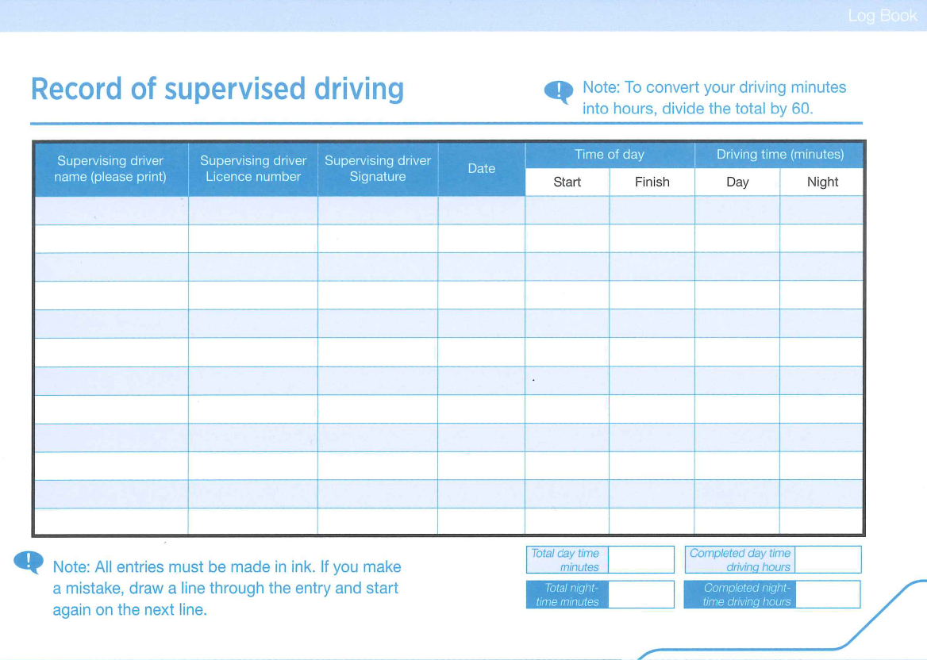
The log book.
Notes:
Notes:
Conditions to the completion of the log book:
The log book is a legal document and false or misleading information will cause those that have signed this document, liable to prosecution. (page 1 Log book )
If the logbook is misplaced or lost you are required to purchase another log book and to start your hours again
A person must complete 50 hours of supervised log book hours. (including 5 hours night driving)
1st Phase - 25 hours and remain in this phase for at least 6 months
2nd Phase - 25 hours
The learner driver may complete the log book in an automatic vehicle even if they have completed their practical test in a manual vehicle
The learner’s permit and the log book are only valid in Western Australia

Slide 8
Learning step by step.
P
Build on experience
Practising manoeuvres
Developing hazard perception skills
Learning basic techniques
Moving off and changing gears
Understanding car controls
L
Notes:
Notes:
It is suggested that as a Learner Driver, you should start with the basics and build-up to the more complex aspects of driving. When you are competent and confident enough, you move to the next step
Understanding the car controls
Learn the car’s controls and develop skills in the use of mirrors, indicators, steering, seat and seatbelt adjustments
Moving off and changing gears
Learn the location and operation of gears, pedals and clutch to develop the ability to operate the controls whilst the vehicle is in motion
This should be done in a quiet, open, unobstructed area, like a car park on a Sunday or a new suburb development
Learning basic techniques
Learn the system of car control when approaching intersections (mirrors, indicator, 2nd gear and clutch up)
Developing hazard perception skills
Start to scan the environment and identify potential hazards that pose a risk to yourselves and other road users.
You should be able to react to various traffic situations and make safe driving decisions.
Practising manoeuvres
Practise manoeuvres such as roundabouts, traffic lights, parallel parking, three-point turns, changing lanes and turning right.
Building on your experience
Start to build on experience by driving in range of conditions, such as busy traffic areas, at different times of the day and in different weather conditions.

Slide 9
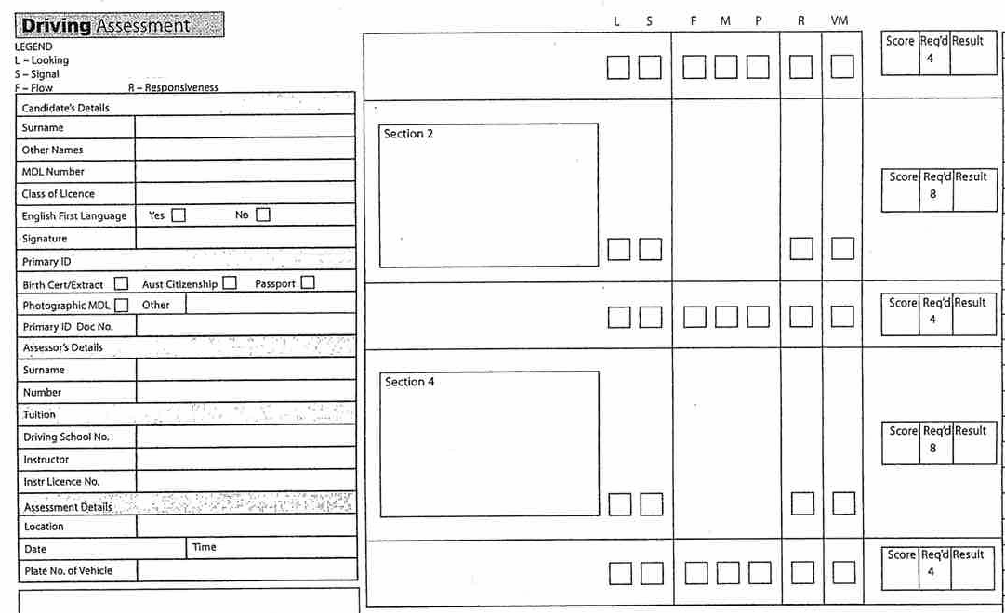
Practical driving assessment.
Notes:
Notes:
The practical assessment looks at the quality of your driving rather than the way you perform individual skills. When a learner driver shows signs of high quality driving it usually means that they have had plenty of practice and have encountered many different driving experiences.
The assessment has five sections:
3 sections you will be asked to follow directions
2 sections you will have to perform set exercises - ‘Stopping for Shopping’ & ‘Left Something Behind’
The items your driving will be assessed against are:
Flow which assesses how well you combine driving skills together;
Movement which assesses whether you move smoothly when you drive the car forwards or backwards;
Path which assesses whether you pick the best track and stay on track
Responsiveness which assesses whether you are aware of the hazards around you and respond to them appropriately;
Look Behind which assesses whether you keep an eye on what’s happening behind and around you as you drive;
Signal which assesses whether you let other road users know what you intend to do; and
Vehicle Management which assesses whether you do things like keeping an eye on your vehicle’s instruments while you are driving.
The driving part of the assessment will take around 35 minutes. When you arrive back at the Assessment Centre the assessor will tally up your score to see if you have passed the assessment and your assessor will give you ‘feedback’ on how you went. This may take up to ten minutes.

Slide 10

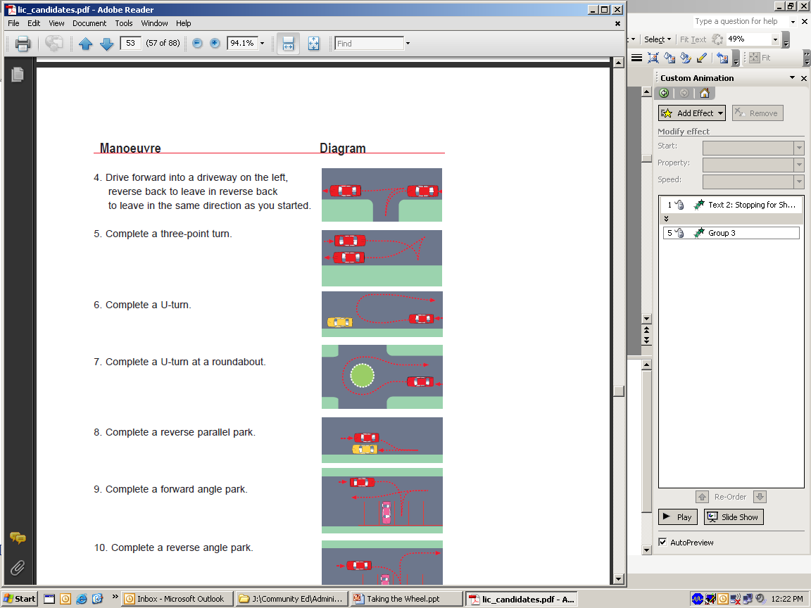
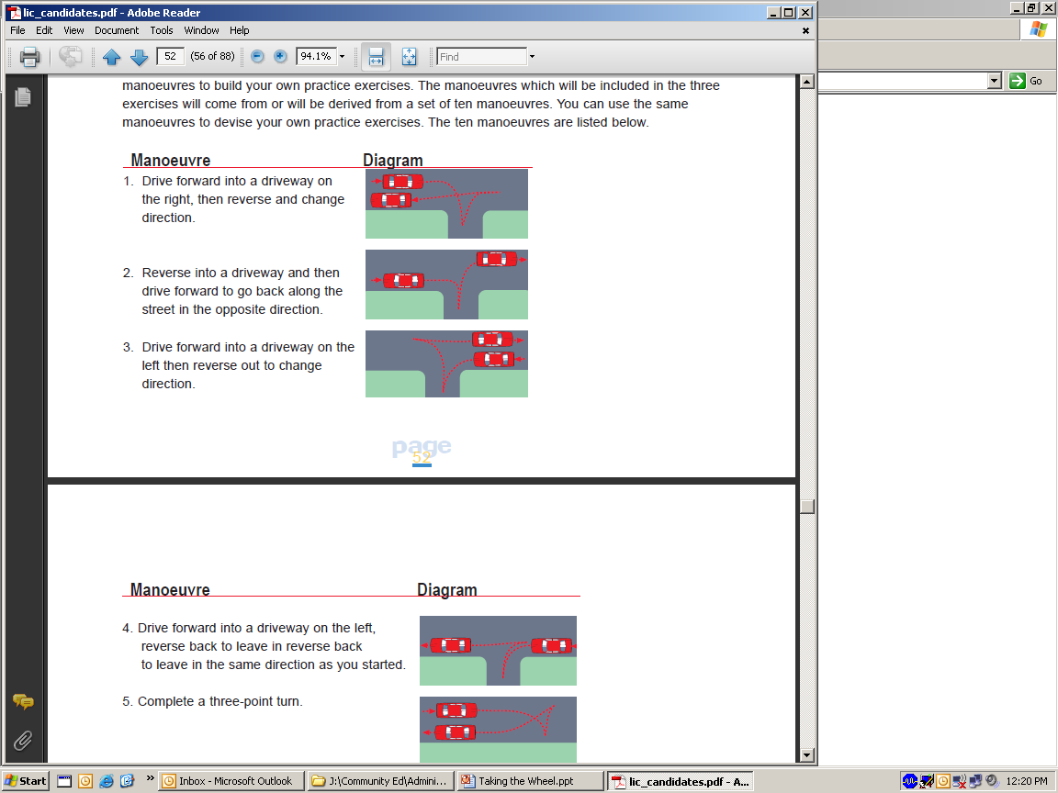
Left something behind.
Where are you NOT allowed to do a U Turn?
Turning around to go back by:
  Completing a 3 point turn
  Using a roundabout
  Using a driveway
  Completing a U-turn
Notes:
Notes:
READ: You have just visited a friend’s house. You drive off around the next corner and then remember you have left something behind at the house. You need to go back to the house, collect the item and then set off again.
You will be required to choose the most appropriate maneuver for the situation.
This may involve performing one of the following maneuvers:
Completing a 3 point turn (not recommended on a busy road)
Completing a U-turn (if road is wide enough)
Using a roundabout (if one is available)
Using a driveway
Hints and tips
Do not go past the letter box - if you pass the letter box you are going onto private property and will lose points in your driving test
Reverse on the correct side of the road beside the curb
Always look over your shoulder when reversing, check mirrors and your blind spot

Slide 11
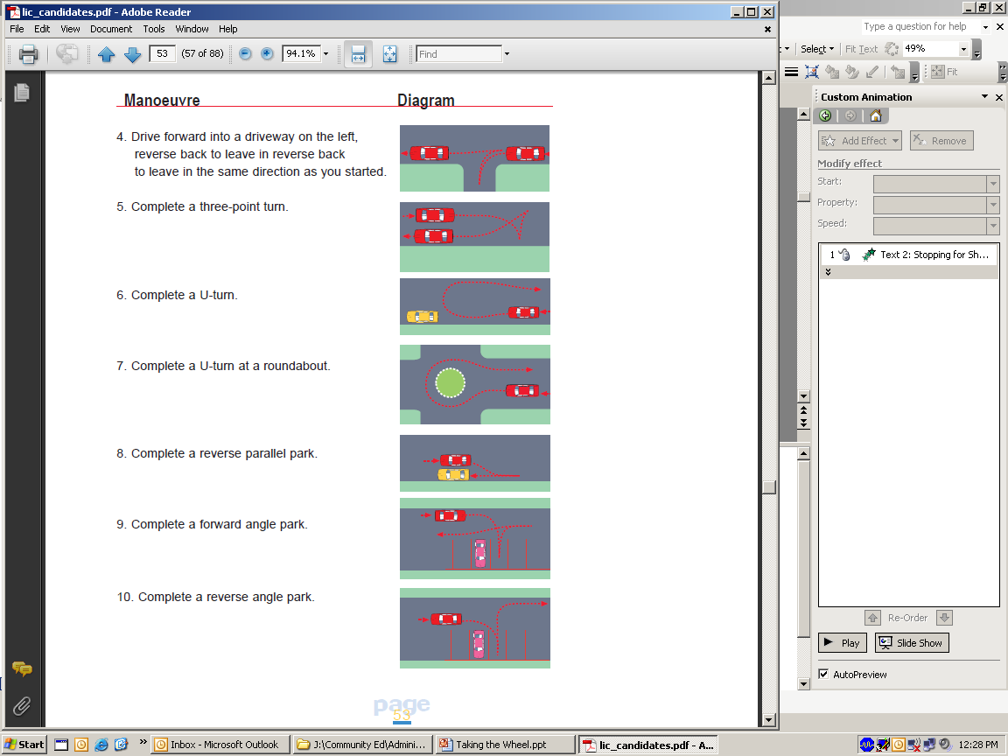
Stop for shopping.
Turning around to go back by:
  Parking in a car bay next to another vehicle
Notes:
Notes:
READ: You have just passed a shopping centre complex and the Driving Assessor may ask you to return to the shops to demonstrate parking skills.
Turning around to go back
You will be required to choose the most appropriate maneuver to turn around. This may involve performing one of the following maneuvers:
Completing a 3 point turn
Completing a U-turn
Using a roundabout or
Using a drive way
Parking in a car park:
Entering a car park and parking next to another vehicle
entering the parking space forwards or
entering the parking space backwards
In summary you may be asked to perform any of these manoeuvres:
Drive forward into a driveway on the right, then reverse and change direction.
Reverse into a driveway and then drive forward to go back along the street in the opposite direction.
Drive forward into a driveway on the left then reverse out to change direction.
Drive forward into a driveway on the left, reverse back to leave in reverse back to leave in the same direction as you started.
Complete a three-point turn.
Complete a U-turn.
Complete a U-turn at a roundabout.
Complete a reverse parallel park.
Complete a forward angle park.
Complete a reverse angle park.

Slide 12
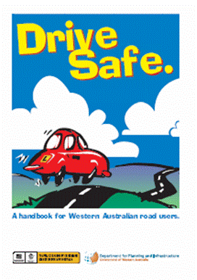
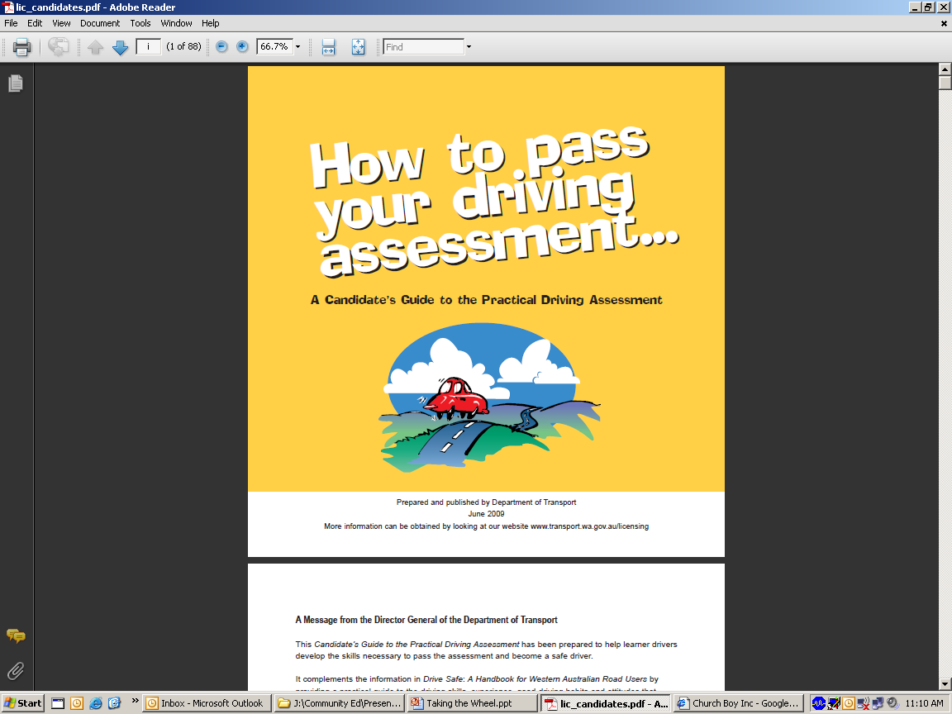
Free resources.
Department of Transport
Notes:
Notes:
These are two documents that are valuable in your preparation for your PDA. They are both available at the Department of Transport.
You should read these books thoroughly to increase your awareness of the processes, for getting your drivers licence,
Drive Safe: http://dpi.wa.gov.au/licensing/learnerdrivers/1464.asp
How to pass your PDA: http://dpi.wa.gov.au/mediaFiles/lic_candidates.pdf

Slide 13

Notes:
Notes:
Now its time for a quiz.

Slide 14
Question 1.
How far should you drive behind a vehicle?
.
a) at least 2 seconds
b) at least 5 seconds
c) about 3 car lengths
Notes:
Notes:
ASK: How far should you drive behind a vehicle?
Click for the an answer: A (at least 2 seconds)
ASK: Who can explain the 2 second rule?
Click for an answer: Pick an object on the side of the road, like a tree or a pole that the car in front passes. Count to yourself 1001, 1002. By the time you have finished counting the full two seconds you should have reached the object or be approaching it. If you get to the object before you finish counting you are too close.
ASK: When would you increase your following distance from 2 sec to 3 or 4 sec?
Answer: When your vision is impaired (i.e. smoke, ice, dust , fog, rain)
Source: Department of Transport, Drive Safe Book 1st October 2013 page 49

Slide 15
Question 2.
How long must you indicate before turning?
.
a) at least 70 metres before the turn
b) long enough to give enough warning to other road users
c) you don’t need to indicate
Notes:
Notes:
ASK: How long must you indicate before turning?
Click to answer: B (long enough to give enough warning to other road users)
Background information:
You must give sufficient warning to other drivers and pedestrians of your intention to turn or diverge right or left, change lanes or overtake another vehicle.
The definition of sufficient warning depends on the circumstance. It is about providing warning of your intentions so that other road users can take the appropriate safety precautions. On high speed roads, indicating may be necessary for several hundred metres, while on low speed roads much lesser distances may be sufficient.
Source: Drive safe book, p 65: 1st October 2013

Slide 16
Question 3.
Which of these statements is correct?
.
a) ornaments hanging from the rear view mirror will stop you from becoming fatigued when driving
b) sunglasses worn at night will reduce the glare from the headlights of on-coming vehicles
c) you should have a clear windscreen and clean headlights at night
Notes:
Notes:
ASK: which statement is correct?
Click to answer: C (you should have a clear windscreen and clean headlights at night)
Background information:
Your car must not have:
Any ornament or fitting which may cause injury in a crash
Any toy or mascot attached to the window, windscreen, rear view mirror, dash panel or any other part of the vehicle, that may obstruct the driver’s view or cause distraction in any way
If a vehicle comes towards you with lights on high beam:
Slow down, look to the left of the road, keep to the left of the road and if you cannot see, stop.
Source: Department of Transport, Drive Safe Book 1st October 2013 page 51 & 52

Slide 17
Question 4.
What must you do before pulling out from a curb?
.
a) sound your horn
b) check your mirrors, blind spot and indicate for at least 5 seconds
c) adjust your passenger-side external mirror
Notes:
Notes:
ASK: what must you do before pulling out from a curb?
Click to answer: B (check your mirror, blind spot and indicate for at least 5 seconds)
Background information:
If you are starting from a stationary position at the side of a road you must indicate for at least 5 seconds prior to driving on. You must also give way to following or overtaking traffic. Do not drive on until it is safe to do so. Remember to turn the indicator off after the turn/movement has been completed.
Source: Drive safe book, p 65: 1st October 2013

Slide 18
Getting ready.
Practical Driving Assessment (PDA)
Practice in all weather conditions including sunset
Practice driving around trucks
Practice merging and driving on freeway
Practice driving in peak hour traffic
Practice driving on regional open roads
Practice driving in the area you will set your assessment
The more logged hours of driving practice in the 1st phase, the more confident you will be throughout your assessment.
Notes:
Notes:
Get driving practice in all different kinds of situations, such as in the rain, on wet roads, on the freeways, on dirt roads and possibly with road trains.
The more practice you get when you have a fully qualified experienced driver in the car with you, the safer you will be when you are out on the roads as a P plate driver.
Practice in all Weather conditions:
Driving on dry roads are different to wet roads.
The gap behind vehicles should be bigger when the roads are wet.
Practice driving around trucks:
Depending on the load of the truck, some trucks can take up to 1 km to stop. Before overtaking a truck, scan the road and know your completely safe while overtaking the truck. Be mindful of any traffic lights or merging lanes when overtaking.
Practice merging and driving on freeway:
The vehicle in front has the right away. Always indicate when merging.
Practice driving in peak hour traffic:
More hours you drive when the roads are busy the more comfortable you will be as a P Plate driver.
Practice driving on regional open roads:
Practice driving on open roads, will help you to be safer and more aware of hazards, fatigue and speed when you’re a P Plate driver.
Practice driving in the area you will set your assessment:
This is help with not being nervous on the day of your assessment.

Slide 19
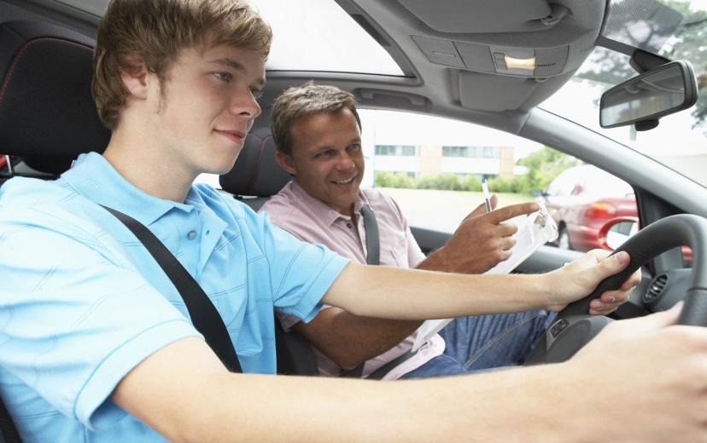
Getting ready.
(PDA)
Don’t tell your friends the test date
Take the test at the right time
Book the test for early in the day
Do a mock test
Notes:
Notes:
To reduce the stress for your PDA you may like to keep these tips in mind:
Don’t tell your friends the test date.
If everyone knows you are going for the test, you create the additional stress of trying to live up to your friends expectations. It's OK to let your Mum and Dad know, we are sure they will give you all the support you need.
Get the timing right.
Take the test at the right time. Try to book the test so it does not coincide with other stressful events (just prior to school exams or in the middle of wedding preparations etc).
Book the first available driving test of the day.
If you take your test early in the morning you will have less time to worry about it.
Do a practice run.
We use the term ‘Mock Test’. The instructor should be very realistic and the student must take it seriously. In your last two lessons ask your instructor to concentrate on the manoeuvres you find most difficult.
http://www.2pass.co.uk/nerves.htm

Slide 20

The day before.
(PDA)
Practice in your head
Get a good night’s sleep
Notes:
Notes:
Practice in your head - it's been proven that you can improve your ability to perform coordinated tasks by imagining doing them.
Get a good night's sleep before the test!
http://www.2pass.co.uk/nerves.htm

Slide 21
The day of.
(PDA)
Take your Learner’s Permit with you
Arrive early
Don’t worry when there is silence in the car
You do not need to be perfect
Notes:
Notes:
Take your Learner’s Permit with you and Log Book with 50 hours of recorded time. You are required to have this on you when you are in control of a vehicle
Arrive early
Arrive approximately 15 minutes prior to the test booking
Sometimes the assessors will like to view the car before the test to ensure it is road worthy
Don’t worry about silence in the car.
It can be daunting sitting beside a stranger, who seems to just grunt: 'turn right, turn left'.
Avoid thinking the examiner doesn’t like you. If there is a little chit-chat, be happy, but don’t expect it.
You do not need to be perfect.
Concentrate on the essentials. If you make a mistake, keep calm and concentrate on your driving. The mistake may not result in failure.
When a competent driver makes an error, such as stalling the car, they immediately restart the engine without interrupting their flow. This is a sign of competence. You can make mistakes and still receive a ‘YES’ for flow.
Remember: Examiners are only human.
Your test is one of possibly eight on the examiners sheet that day. Don’t try to please him/her.
http://www.2pass.co.uk/nerves.htm
The assessor will not proceed with an assessment if:
in the judgment of the assessor, you are not mentally or physically fit for the assessment;
your vehicle is not roadworthy;
your vehicle is not appropriate for the class or type of licence assessment;
the vehicle does not have a centrally positioned handbrake, or dual controls (metro only);
your vehicle breaks down during the assessment;
you offer a bribe or inducement; or
in the judgment of the assessor, something that would not normally be present during a test adversely affects the authenticity, fairness, reliability or validity of the assessment.

Slide 22
The PDA.
Common test mistakes
What is a blind spot?
Not keeping up with the traffic flow
Hitting the curb when parking
Not indicating for long enough
Driving too slow
Not checking your blind spot and mirrors
Notes:
Notes:
These are common mistakes learners make in their practical assessment. You will lose points for doing any of these items.
There are 7 sections on the marking sheet in the test. You need to get 6 out the 7 sections correct to pass.
Don’t stress if the assessor is writing things down. He/she may be ticking boxes you have passed.
The test takes around 35 minutes.
Background information:
Not keeping up with the traffic flow
If there is space to pull out in front of the traffic and you hesitate and do not pull out, you will loose points for this.
Hitting the curb when parking
If you slightly nudge the curb you will not lose any points.
If you hit the curb, you will lose points.
If 2 wheels go up and hit the curb it will be an automatic failure.
Not indicating long enough
Not signalling early enough.
Signalling incorrectly or not signalling when it was practical.
Driving too slow
You can lose points for driving too slowly and not keeping up to traffic.
Not checking your blind spot
Failure to check over your shoulder before pulling away from the kerb or changing lanes. You will loose points for this.
By you not checking your blind spot you may cause an accident or the assessor has to intervene. This is an automatic fail.
ASK: what is a blind spot?
Answer: An area of space around the car that is not visible, through the use of rear view or side mirrors. Check your blind spots by glancing over your shoulder before you move left or right.

Slide 23

The PDA.
Automatic failure
Speeding
Disobeying a road sign or traffic regulation
The assessor takes control of the vehicle
Nearly causing a crash
Driving without wearing your seat belt
Notes:
Notes:
ASK: how do you fail automatically?
Answer: disobey a regulatory sign; speed; or drive without wearing seat belt.
Background information:
You will automatically fail the practical driving assessment if any of the following things occur:
your assessor has to intervene or give you assistance to avoid a potentially dangerous situation;
you disobey any traffic regulation that immediately or potentially threatens safety;
you fail to respond to a crisis or potential crisis that would normally be anticipated by an experienced driver;
you cause a crisis or potential crisis;
You refuse to attempt any part of the assessment; or
you refuse to follow a reasonable direction given by the assessor.
ASK students to share any stories they have.

Slide 24
Coping with a fail.
Listen to the assessor’s feedback
Practice the areas of weakness
Book in another test
Notes:
Notes:
Listen to the Assessor’s Feedback.
Although possibly being overwhelmed with a fail in your PDA it is important to listen to any feedback that the assessor provides at the end of the session.
This will give you a clear idea of what your weaker areas are.
Practice weaker areas.
To practice what you are good at is easy, but ensure you spend time on areas that you are not so confident in (i.e. reverse parking)
READ: the following story of one person’s experience with the PDA
To cope with the disappointment of failing her first driving test, Lucy decided to book her next driving test as soon as possible afterwards. She says, “I felt that sorting out the next driving test and looking forward to the prospect of having another chance to pass would help with my disappointment”. It is common to feel too disillusioned to want to do this, but in putting things off, you risk losing your nerve altogether.
Lucy was very upset to fail her driving test for a second time, especially as she felt that she was better prepared on that occasion. She says, “In a way, I was much more disappointed to fail for a second time as I had not really expected to pass on my first attempt. I genuinely believed that I was a better driver when I took my second test, so I was absolutely gutted to fail again”. As she did before, Lucy immediately booked her third driving test to get herself in the right frame of mind for another attempt.
Book in another test
Emphasise that it’s important to get back on the horse after falling off so you may like to book in another test soon after so you keep site of the vision.

Slide 25
Hazard Perception Test.
For each scene you will be given one of the following driving tasks:
Slow down
Overtake
Make your turn
Move off
Notes:
Notes:
Once you passed your practical test you will be given a log book, make sure you ask for the practice CD ROM and HPT booklet. If you do not ask you will not be give this automatically
Show the practice CD ROM and HPT Booklet
HPT measures your ability to observe, to identify and assess possible traffic hazards and to make timely responses.
You will be tested on 28 scenes from the 4 areas.
To complete the required task, you simply have to click the mouse button or if it isn’t safe to complete the task do not click on the mouse button.
No set pass mark - it is based on perception and graded accordingly.
Must be over 17 years to sit HPT.
Once you hand in your log book you can sit the HPT.
There is a cost involved go to department of transport website for costings.
Now you can practice a simple version of the HPT on the DPI website.
It is under the Learners section on the DPI website page.
You can find it: www.dpi.wa.gov.au/licensing/learnerdrivers/14992.asp

Slide 26

http://www.transport.wa.gov.au/licensing/hazard-perception-test-simulator.asp
Notes:
Notes:
Instructions: Click on the link Notes http://www.transport.wa.gov.au/licensing/hazard-perception-test-simulator.asp
This link will take you to the WA Department of Transport- Licensing hazard perception test.
This computerized test will assess the driver’s ability to respond to different traffic situations and to make safe driving decisions.
Follow the instructions, advise the student's that is just a demonstration regarding the Hazard Perception Test. The actual test is that is held at the Licensing Centre will take roughly 20 mins to complete.

Slide 27
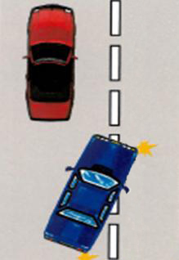
Overtaking.
Is it legal for the car to overtake in each of these diagrams?
Yes
Broken White Lines
No
Solid White Lines
Yes
When it is safe to do so
Notes:
Notes:
Answers appear below picture click to bring up answers.
Remember to only overtake when it is safe and legal to do so.
Broken white lines on left side means he can overtake.

Slide 28
Overtaking.
6 key steps
Get a good view of the road ahead
Look behind and to the side of you
Signal before you overtake
Look AGAIN behind and to the side of you
Keep to the speed limit while overtaking
Move back into line
Notes:
Notes:
Once you passed your practical test you will be given a log book, make sure you ask for the practice CD ROM and HPT booklet. If you do not ask you will not be give this automatically
Show the practice CD ROM and HPT Booklet
HPT measures your ability to observe, to identify and assess possible traffic hazards and to make timely responses.
You will be tested on 28 scenes from the 4 areas.
To complete the required task, you simply have to click the mouse button or if it isn’t safe to complete the task do not click on the mouse button.
No set pass mark - it is based on perception and graded accordingly.
Must be over 17 years to sit HPT.
Once you hand in your log book you can sit the HPT.
There is a cost involved go to department of transport website for costings.
Now you can practice a simple version of the HPT on the DPI website.
It is under the Learners section on the DPI website page.
You can find it:
dpi.wa.gov.au/licensing/learnerdrivers/14992.asp

Slide 29
Keeping your licence.
Traffic offences
Penalties for traffic offences include:
Fines
Demerit points
Loss of licence
Imprisonment
Demerit points stay on your record for 3 years.
Notes:
Notes:
As a driver you must follow the rules and regulations of the road.
Penalties can be imposed by the Courts or by infringement notices.
Demerit points are a form of licence penalty. If you are a fully licenced driver and accumulate 12 points your licence will be suspended for 3 months. The demerit points stay on your record for 3 years after the date of the offence.
As a P plater if you collect 4 points, your licence is cancelled for 3 months and you must complete the Theory and Practical test to obtain your licence again.
Some offences have instant licence disqualification penalties.
You may also be disqualified from driving without incurring demerit points – for example,
if you are convicted of a drink driving offence;
if you offend repeatedly; or
if you are a P plater and are convicted of certain traffic offences like drink driving your licence will be cancelled automatically.
The penalty for failure to display P-plates is $100 and includes instances
in which the incorrect P plate is displayed or when no P-plate is displayed.
If this goes to Court a penalty of $150 may be imposed.
Students have a question in the activity sheet:
“think about two situations where you could gain demerit points for unsafe driving”
(they must think of examples)

Slide 30
Demerit points.
Graduated system
L
L
P
P
12 months
6 months
4 Demerit Points
8 Demerit Points
Notes:
Notes:
Complete the message on the activity sheet regarding demerit points.
Activity:
You can only gain 4 demerit points up to first 6 months into your green p plates
Demerit points are added in the last year; a total of 8 points on green p plates.
Learner Drivers
f 4 or more demerit points are recorded against you, you will be disqualified from holding or obtaining a licence for at least 3 months & your licence cancelled. Once disqualification period has been completed, you can resume your driver training on your existing Learner’s Permit, provided the permit has not expired or been cancelled.
Novice Drivers Type 1
(Held licence for less than 1yr)
if 4 or more demerit points are recorded against you, you will be disqualified from holding or obtaining a licence for at least 3 months & your licence cancelled. You will need to re-apply for a new driver’s licence and also re-sit your Computerised Theory Test and Practical Driving Assessment.
Novice Drivers Type 2
(Held licence for more than 1yr but less than 2yrs)
if 8 or more demerit points are recorded against you, you will be disqualified from holding or obtaining a licence for at least 3 months & your licence cancelled. You will need to re-apply for a new driver’s licence and also re-sit your Computerised Theory Test and Practical Driving Assessment.

Slide 31
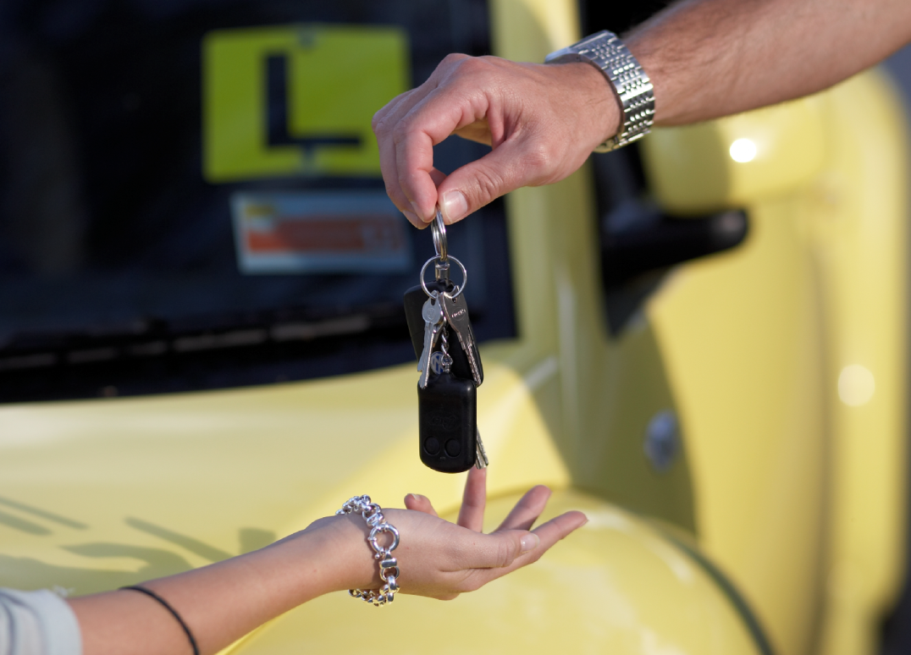
In summary.
Get as much practice as possible
Persevere!
Notes:
Notes:
Encourage students as much as possible the more hours of practice and logged with a supervisor in the first phase of their learners permit, the more confident they will be to pass their assessment.
Encourage the more hours they log with a supervisor the more chance of risk of crashing a vehicle.

